Slide 1
Music Genre Classification
Namita Anandaram

Slide 2
Goal
To build a music recommendation engine.
Understand user behavior using their music choice
When new music file is added recommend a specific genre based on user’s interest
System first has to learn to classify the genre
Achieve at least 80% accuracy in identifying the genre
Identify user behavior to understand user bias to specific genre for recomedation
Note: due to lack of time and data, this project is scoped to genre classification alone

Slide 3
Outline
Data set from GTZAN
Using Librosa to extract features from the Audio files
Audio -> Spectrogram -> Feature data
Uploading into Amazon AWS for Colab connection
Using Colab to Test and Train Data
Random Forest
KNN
Kmean (unsupervised learning)
Conclusion

Slide 4
Data
GTZAN dataset
The dataset consists of 1000 audio tracks each 30 seconds long.
The 10 genres are:
Blues
Classical
Country
Rock
Disco
Reggae
Hip-hop
Jazz
Metal
Pop

Slide 5
Tools & technologies
Technologies Used:
Libraries used:
Pandas
Amazon AWS
Google Colab
Python
Matplotlib
Sklearn Library
Librosa
Ensemble

Slide 6
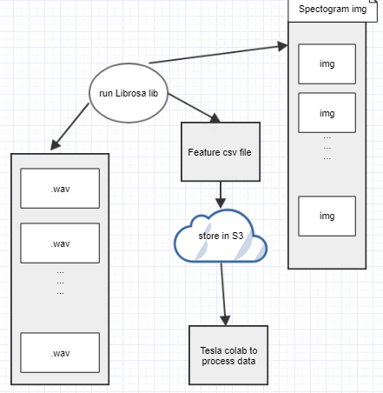
Workflow

Slide 7
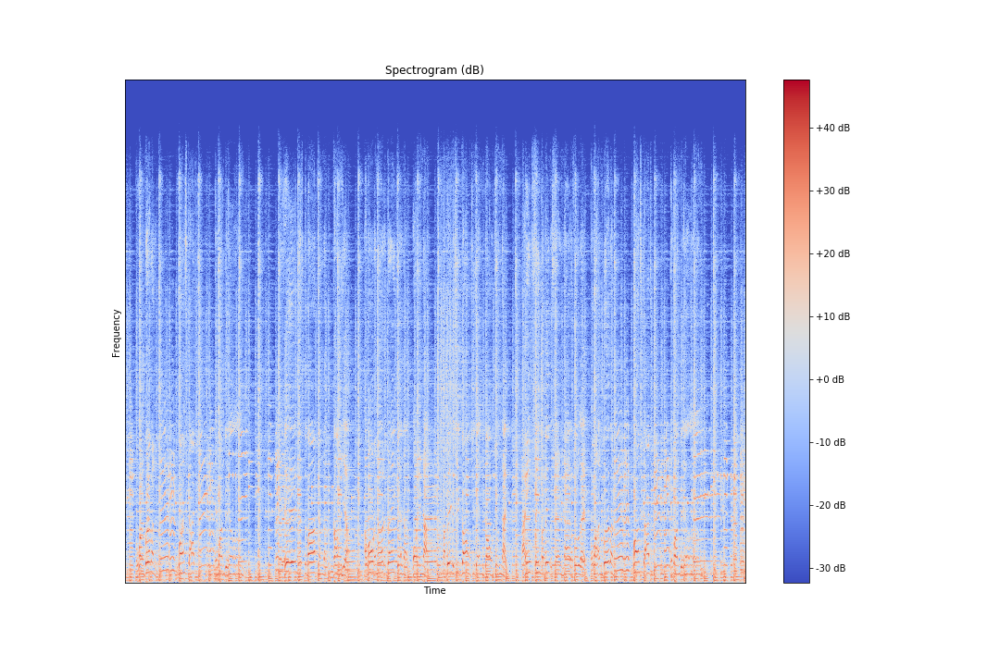
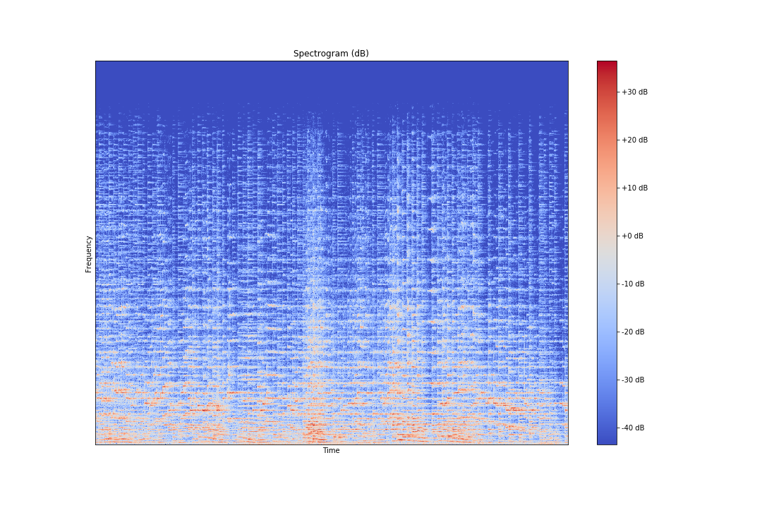
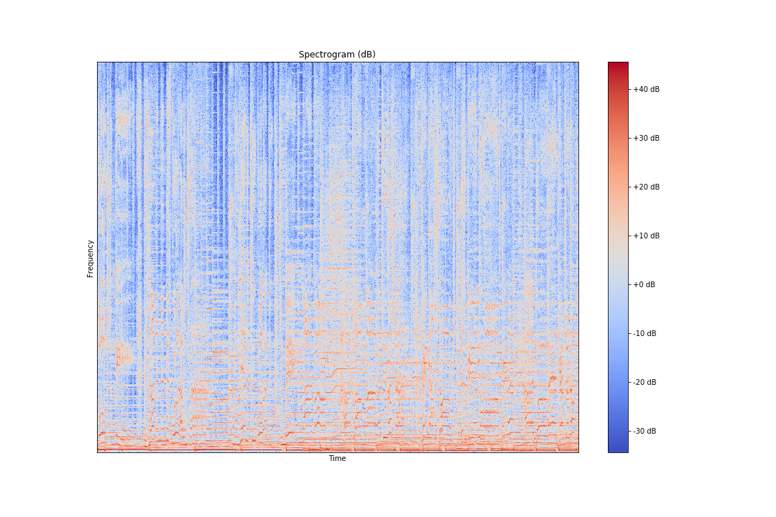
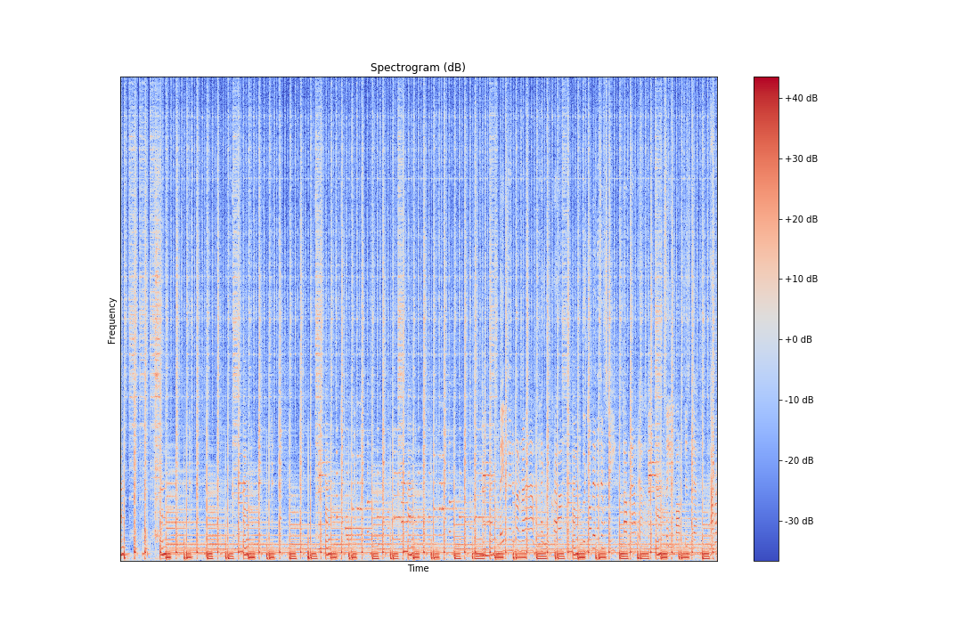
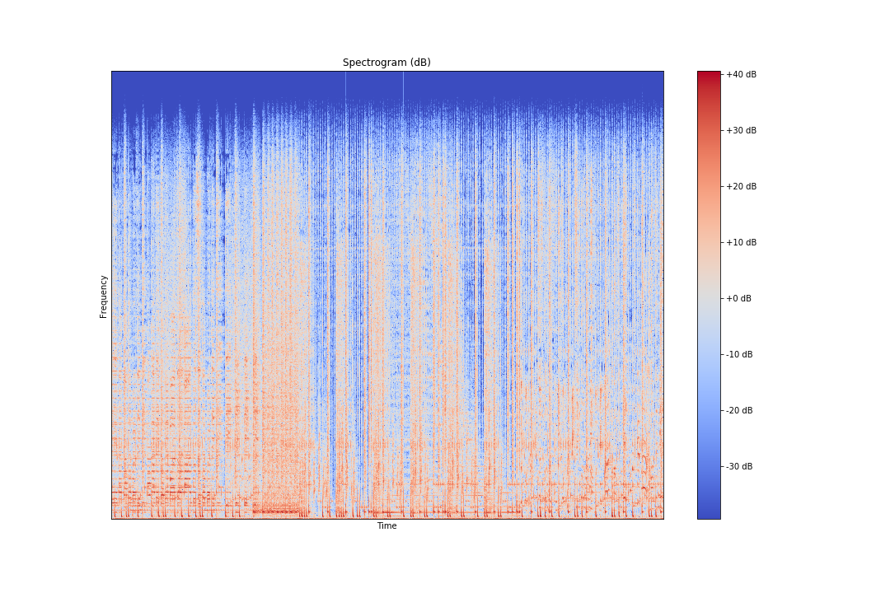
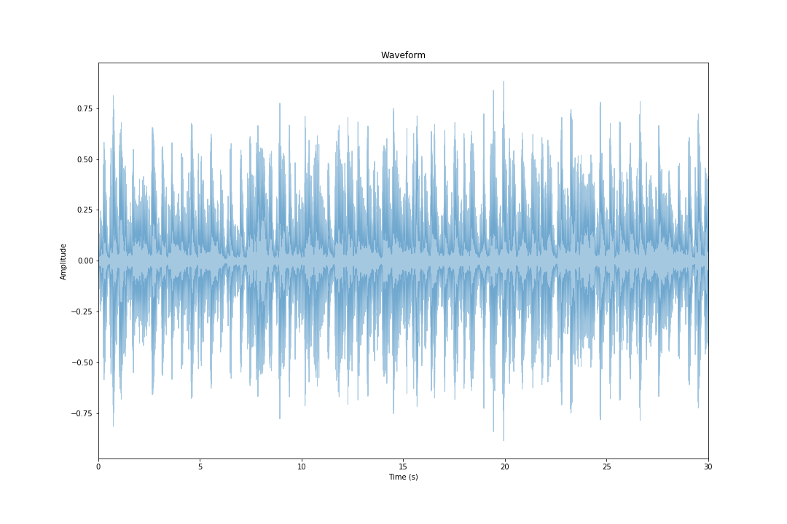
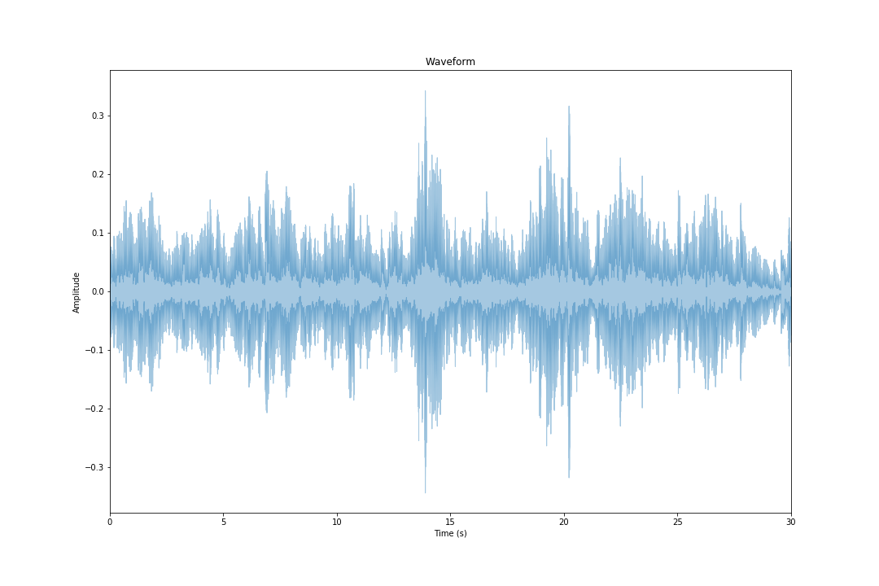
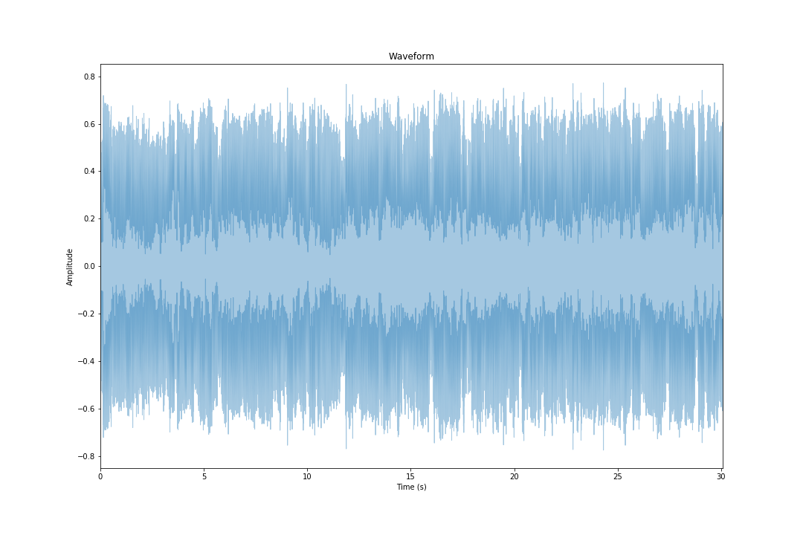
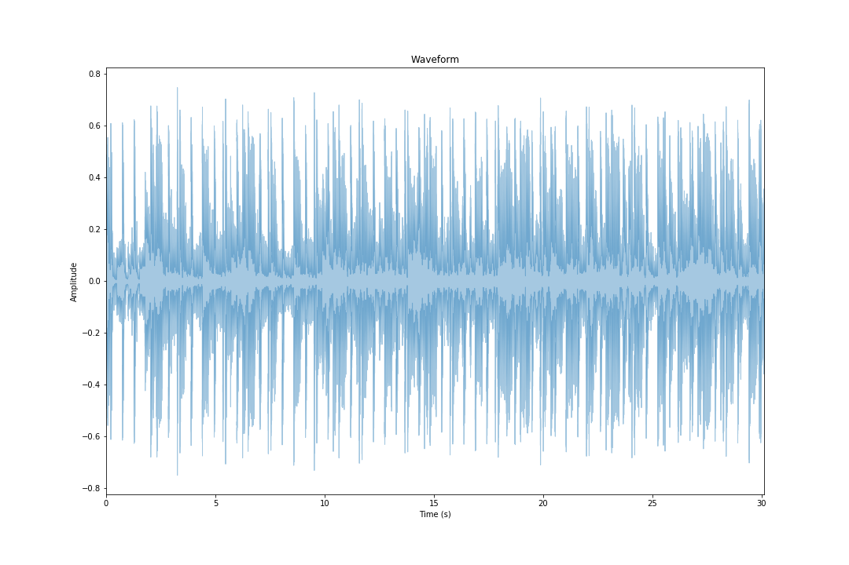
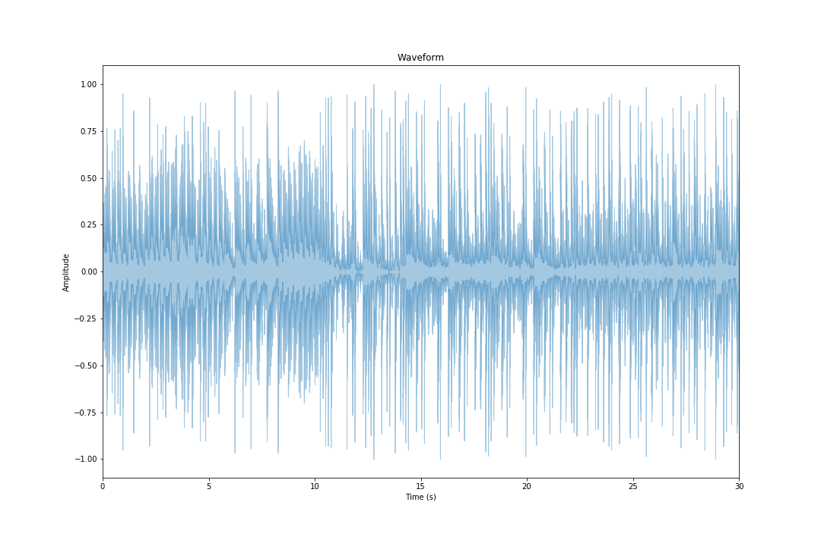
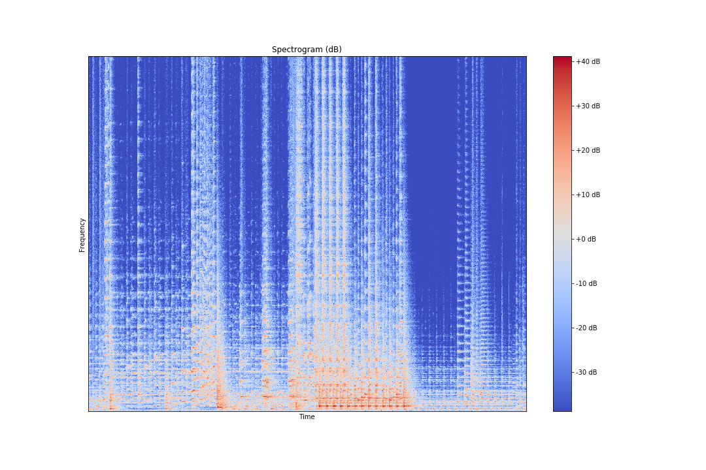
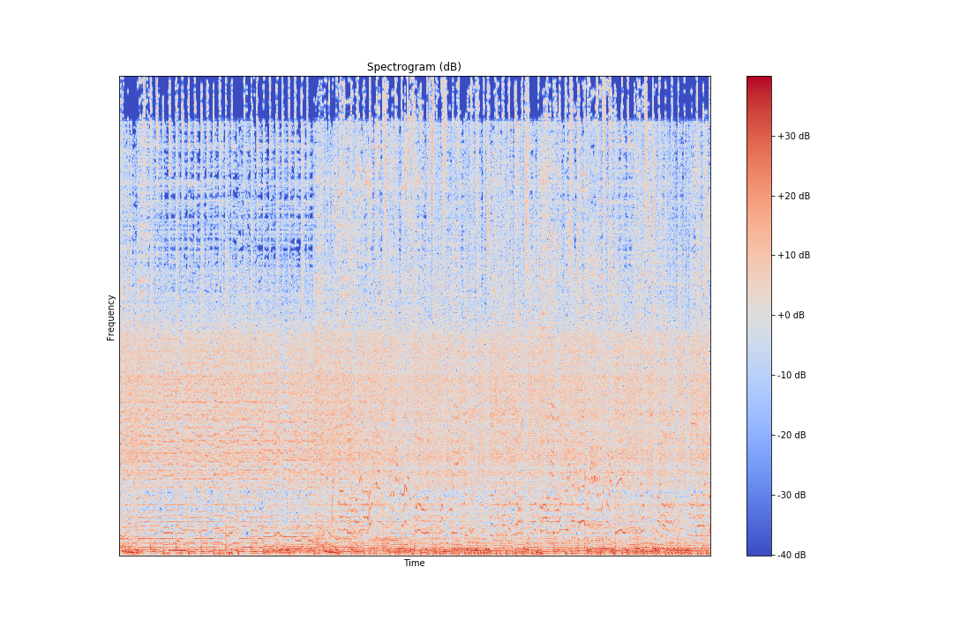
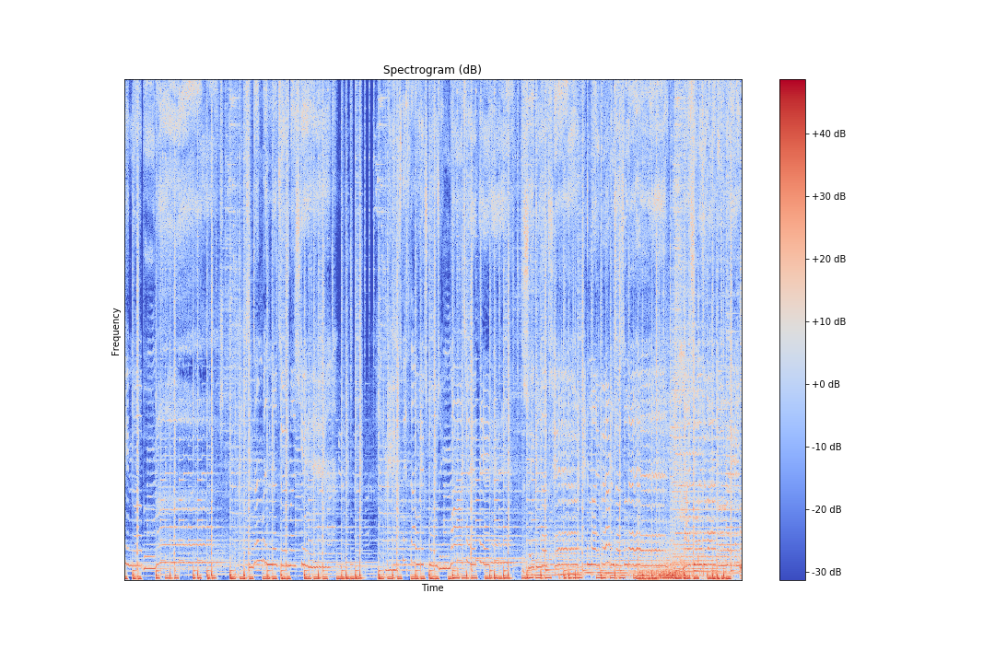
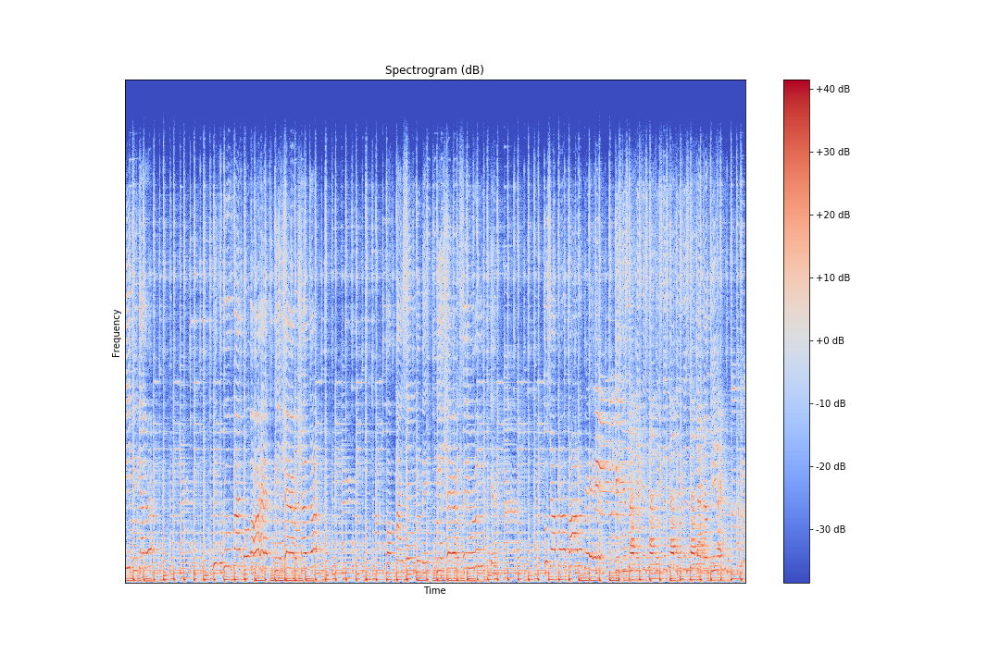
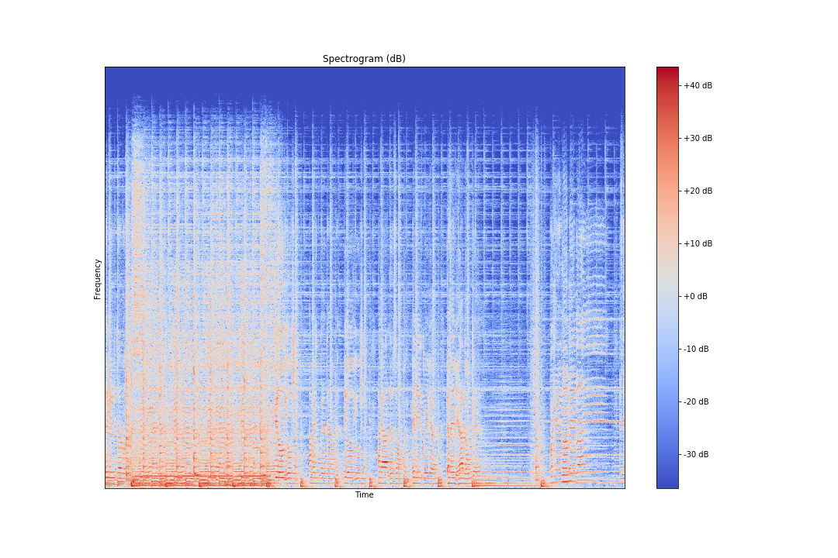
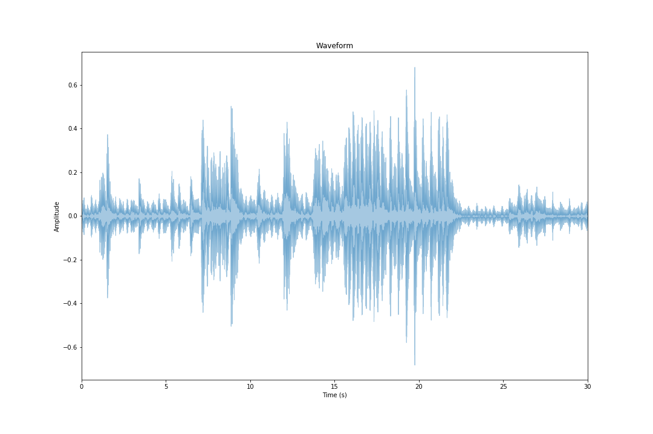
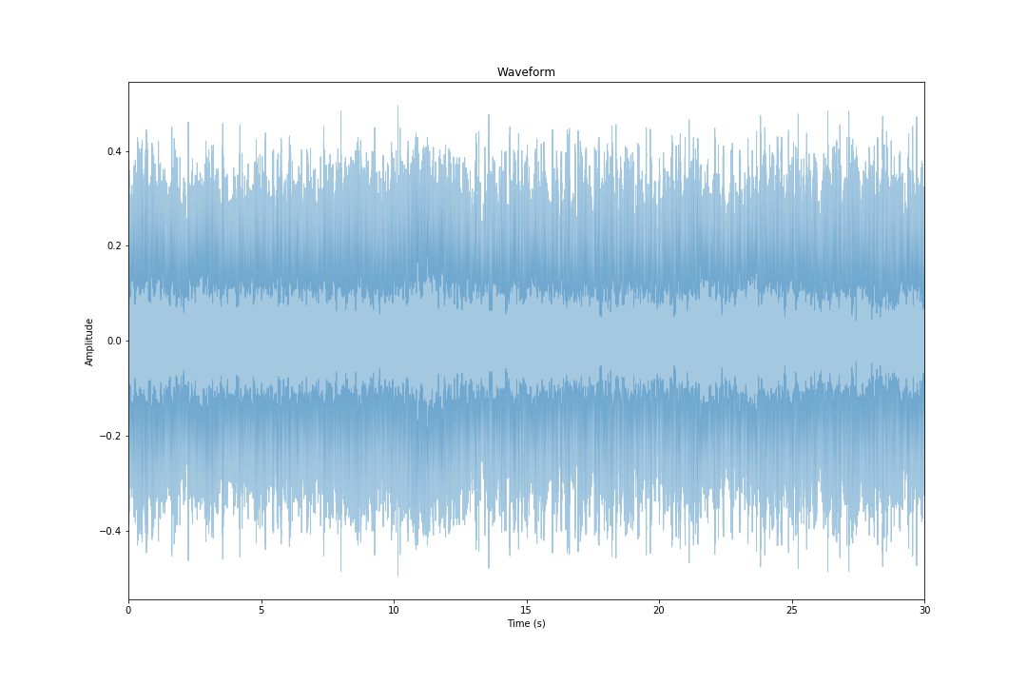
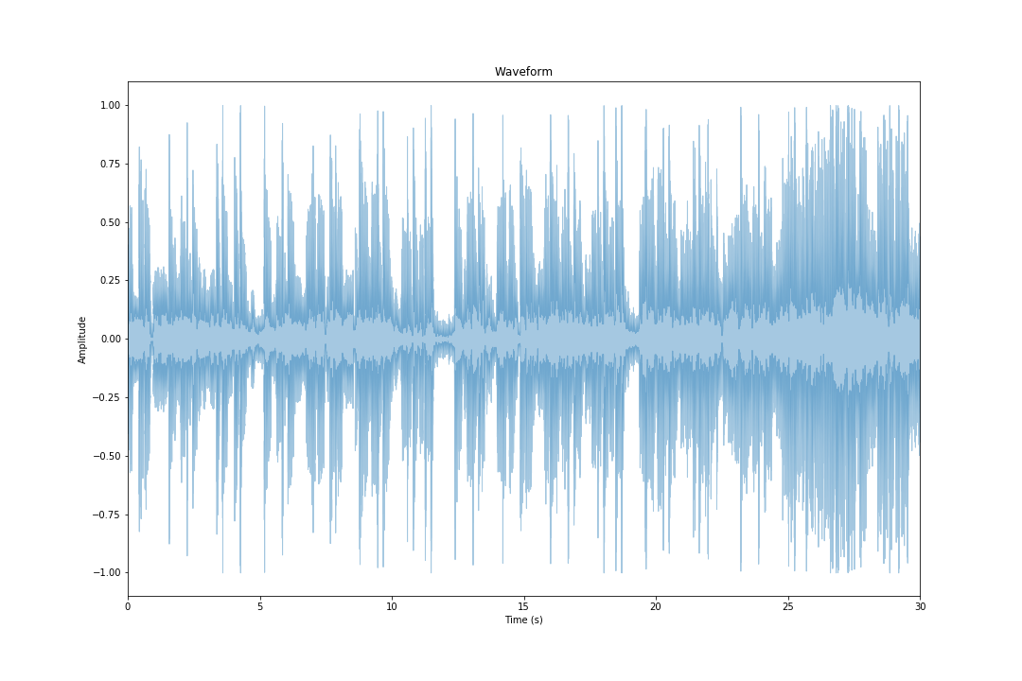
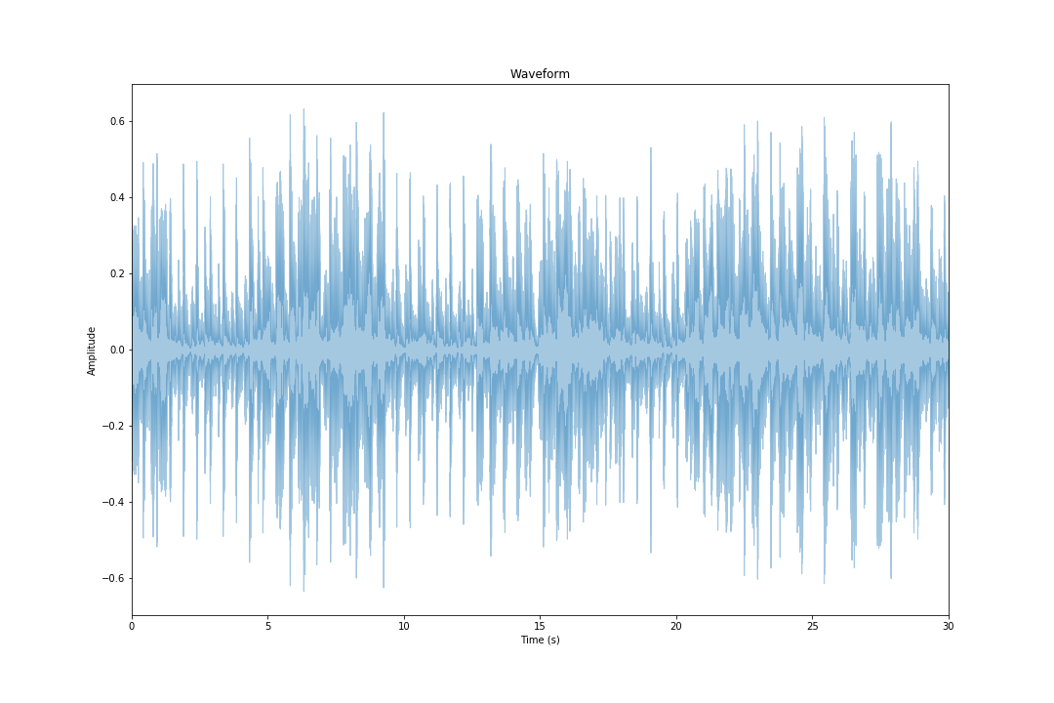
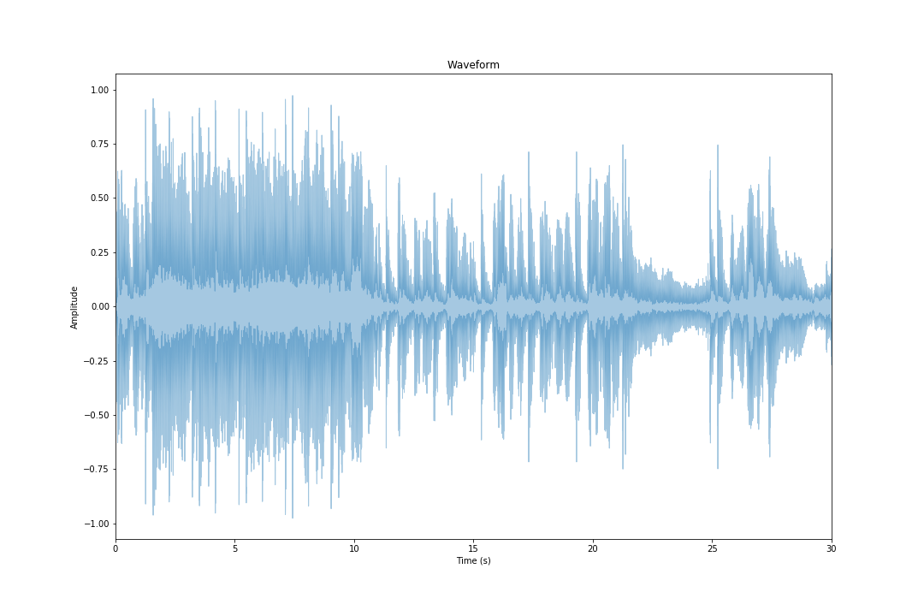
Spectogram and Waveform
Blues
Classical
Country
Disco
Hip-Hop
Jazz
Metal
Pop
Reggae
Rock

Slide 8
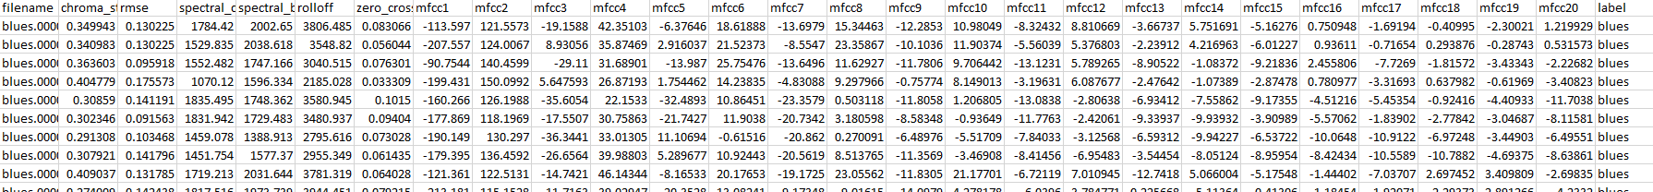
Output
Spectogram
Visual representation of the spectrum of frequencies of sound or other signals as they vary with time with vertical axis showing frequencies and horizontal showing time
Zero Crossing Rate
The rate at which a signal changes from positive to negative.

Slide 9
Feature extraction
Filename
Chroma_stft –Short-time Fourier transform
Determine the sinusoidal frequency
Spectral_centroid
Indicates where the “Center of mass” for a sound is located
Chroma frequencies
Entire spectrum is projected onto 12 bins representing 12 distinct seminotes
Rolloff
The reduction of signal level as the frequency of the signals moves away from the cut-off frequency
Zero crossing rate
Rate of sign-changes along a signal
Mfcc {1-20} - Mel-Frequency Cepstral Coefficients
Describes the overall shape of a spectral envelope
Label – The genres

Slide 10
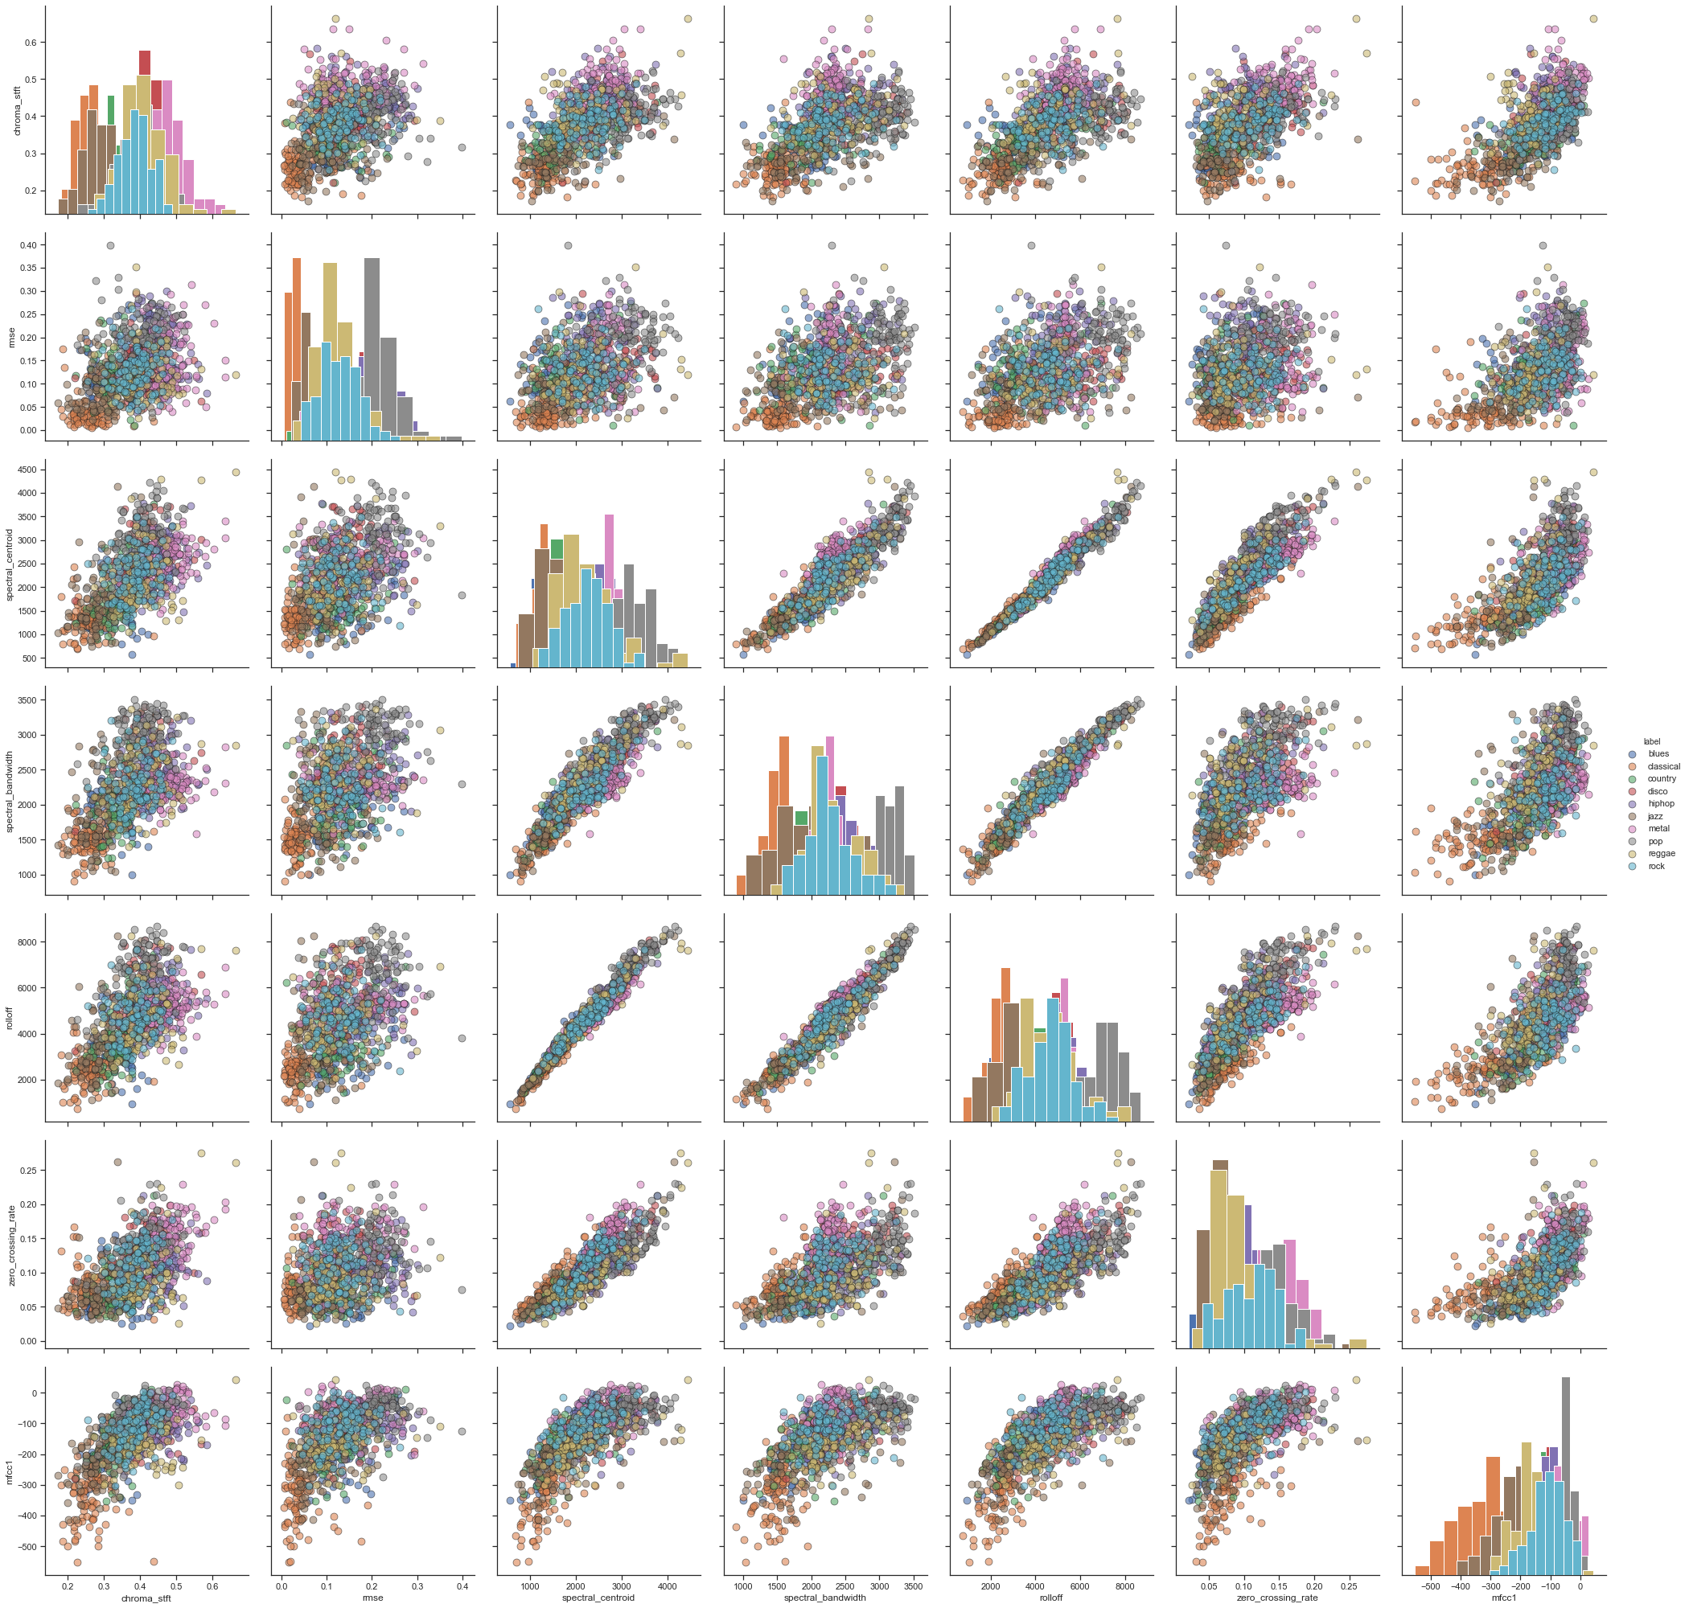
Exploratory data analysis

Slide 11
Features selection and Scaling
Standard scalar
Transform each value to the range about the mean 0 and standard deviation 1
Used if data distribution is normal
MinMax Scalar
Values is transformed proportionally with in range [0,1]
Used as first scalar choice since it preserves the shape of data set( no distortion)
Robust Scalar
Used for data with outliers
Except file name all 28 numeric feature were used for the model
Since the features were extracted from a wav file there were no missing or zero values in the features

Slide 12
Random forest
Ensemble
Machine learning concept training multiple models using same learning algorithm
Minimizes noise, bias and variance and improve stability and accuracy
Bagging
To predict the class of data N learners are applied to the new observation
Result is obtained by averaging the response of N learners ( majority vote)
Scaling | Training Score | Testing score
Standard | 90% | 61%
MinMax | 90% | 61%
Robust | 28% | 61%

Slide 13
Parameter optimization
New fit combination generated 3240 fits for each 1080 candidates
Forest_grid_model.best_score_ resulted in 59% accuracy less than original parameter value.
Abandoned parameter optimization as the score was not better than 61%
Parameter | Original | New fit | Description
Criterion | gini | Gini, entropy | Measures quality of fit
Max-Depth | none | 3,5,7,9,10 | Maximum depth of tree
Max_features | auto | Auto, log2 | Number of feature to consider for best split
Min_sample_leaf | 1 | 1,2,4 | Min samples required to at a leaf node
Min_sample_split | 2 | 2,4,6 | Min sample required to split an internal node
bootstrap | true | True, false | If False whole data set is used to build each tree
N_estimators | 100 | 100,130,150 | Number of trees in the forest

Slide 14
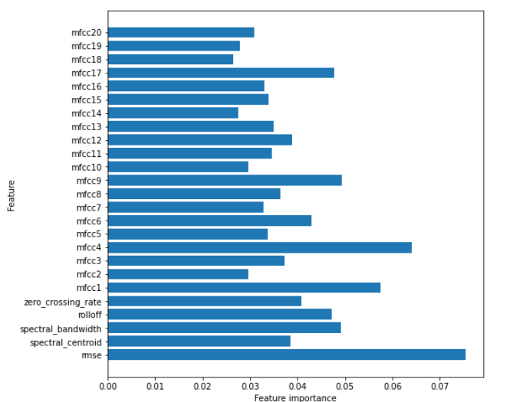
Feature importance
Since most of the feature fall within similar range all feature could be used for the Forest model.
Rmse feature shows highest usage

Slide 15
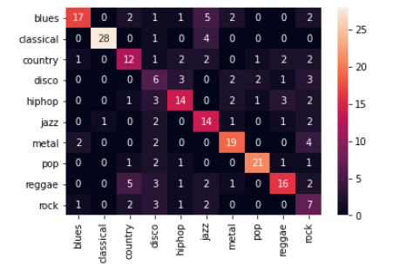
Classification report
Confusion matrix
class | precision | recall | F1-score | support
Blues | 0.81 | 0.57 | 0.67 | 30
Classical | 0.97 | 0.85 | 0.90 | 33
Country | 0.52 | 0.52 | 0.52 | 23
Disco | 0.25 | 0.35 | 0.29 | 17
HipHop | 0.61 | 0.54 | 0.57 | 26
Jazz | 0.48 | 0.67 | 0.56 | 21
metal | 0.70 | 0.70 | 0.70 | 27
Pop | 0.84 | 0.78 | 0.81 | 27
reggae | 0.67 | 0.53 | 0.59 | 30
Rock | 0.28 | 0.44 | 0.34 | 16
Accuracy |  |  | 0.62 | 250
Macro ave | 0.61 | 0.59 | 0.60 | 250
Weighted ave | 0.66 | 0.62 | 0.63 | 250

Slide 16
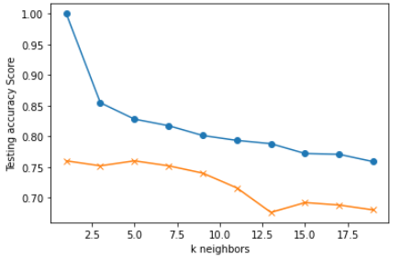
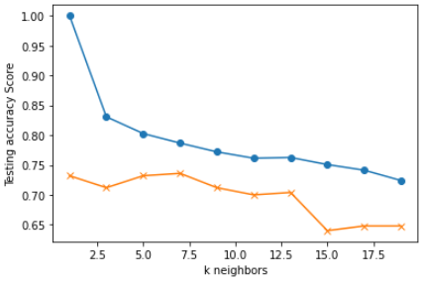
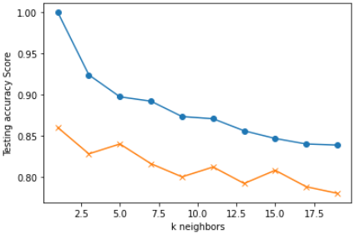
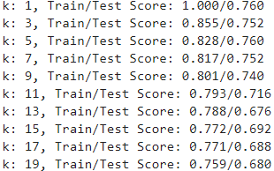
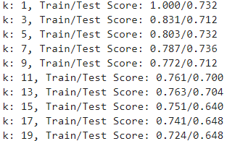
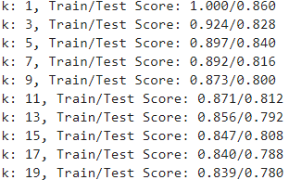
KNN
Standard scale
MinMax scale
Robust scale
K=13, Test Acc : 0.676
K=13, Test Acc: 0.70
K=13, test Acc: 0.792

Slide 17
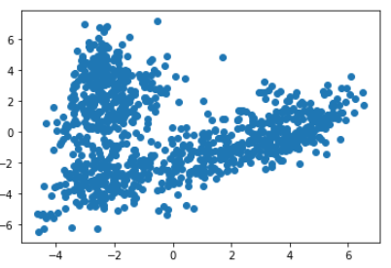
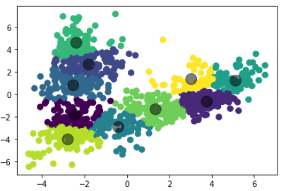
Kmeans
PCA Scatter
Cluster

Slide 18
Conclusions & future work
Random forest was not the best fit.
More samples dint help increase test accuracy significantly
Parameter optimization resulted in lesser model accuracy
KNN had better accuracy compared to RF
Robust scaling had higher accuracy upto 80%
Since the data has more outliers KNN is better fit than RF
Since the goal is music genre classification which further can be used for recommendation engine, it is not mission critical system less tolerant for errors, hence 80% accuracy will still be a good fit for the application.
Future work is to put this into a music recommendation engine.

Slide 19
Thank you!!! Questions??

